Slide 1

How do you build a pitch deck for your start-up?
The Oxford Foundry event
2nd March, 5:30pm - 8:30pm
Workshop

Slide 2
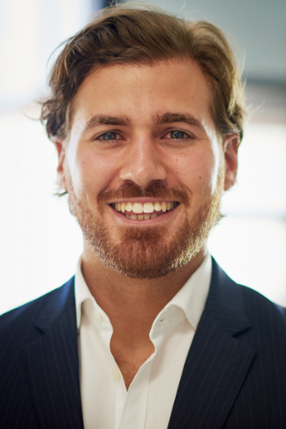
Dario de Wet
Dario is a Venture Associate at Anthemis, contributing to the investment pipeline as well as the ideation and development of commercially viable and investable concepts.
He has a demonstrated history of working with/within FinTech, Internet and Startup businesses in the TMT space. Prior to joining Anthemis, Dario worked within the Strategic Partnerships team at JUMO, whereby he was involved in the support and development of prospective MNO, FSP and Technology partnerships across new and existing markets. Other experience lies within a tech-focused boutique investment bank turned private equity fund for developing markets; where he worked on the merger of Ringier Africa and One Africa Media to create and grow Africa's largest online classifieds group - Ringier One Africa Media (ROAM).

Slide 3
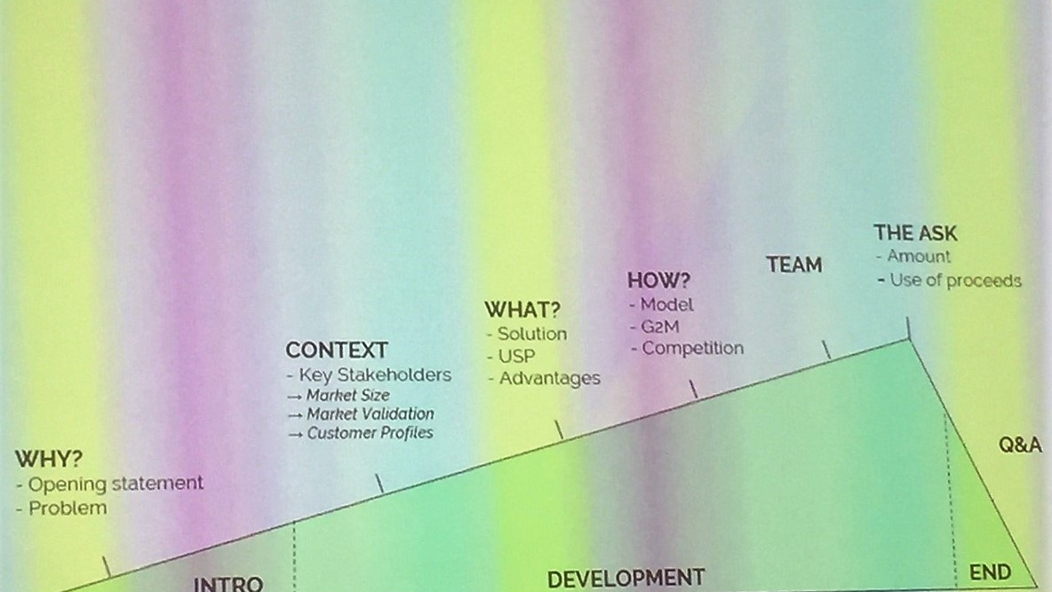
Pitch Framework

Slide 4
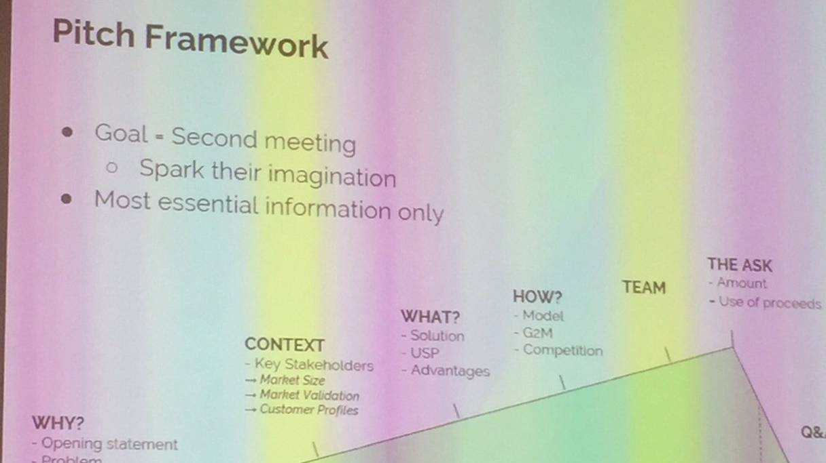

Slide 5
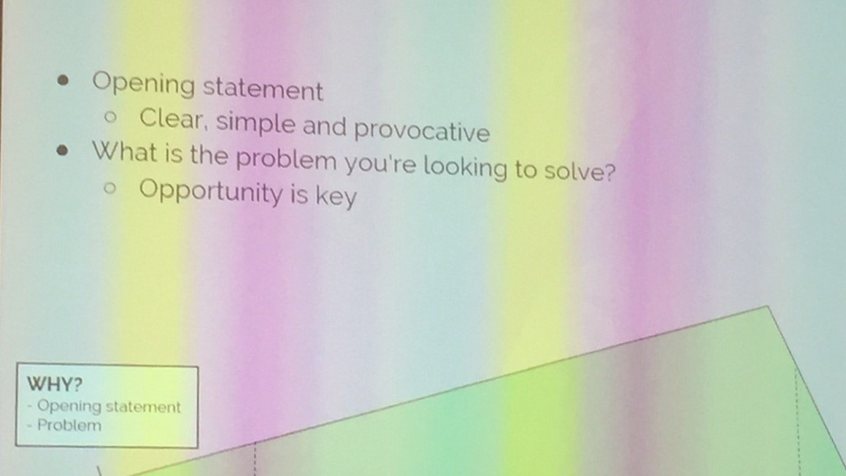
Why?

Slide 6
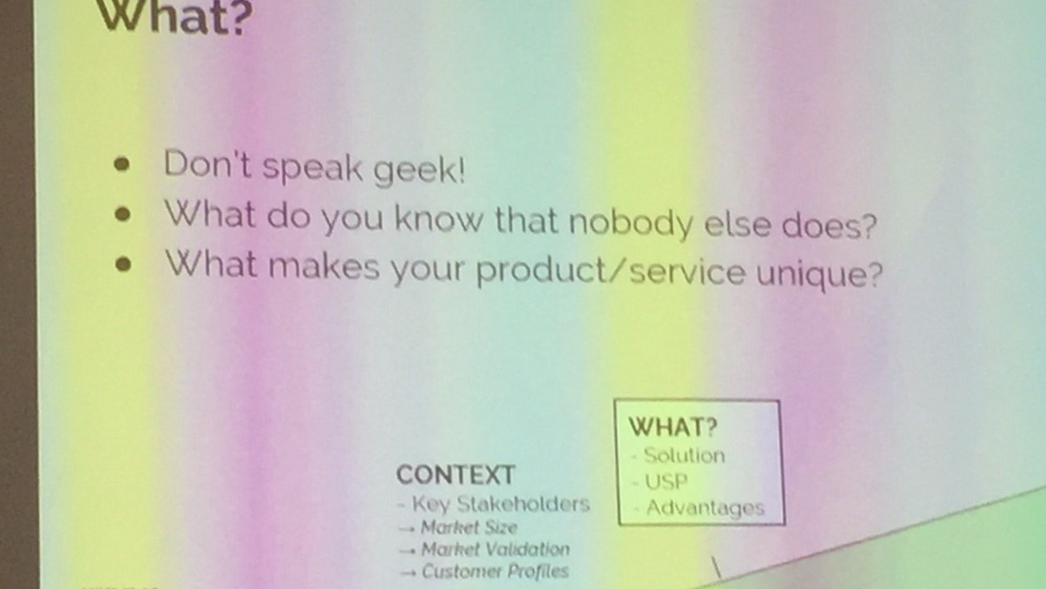

Slide 7
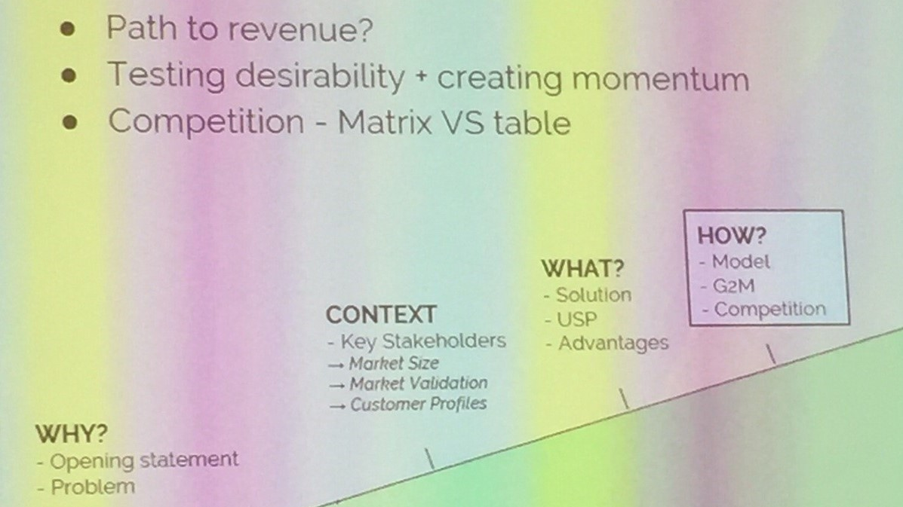
How?

Slide 8
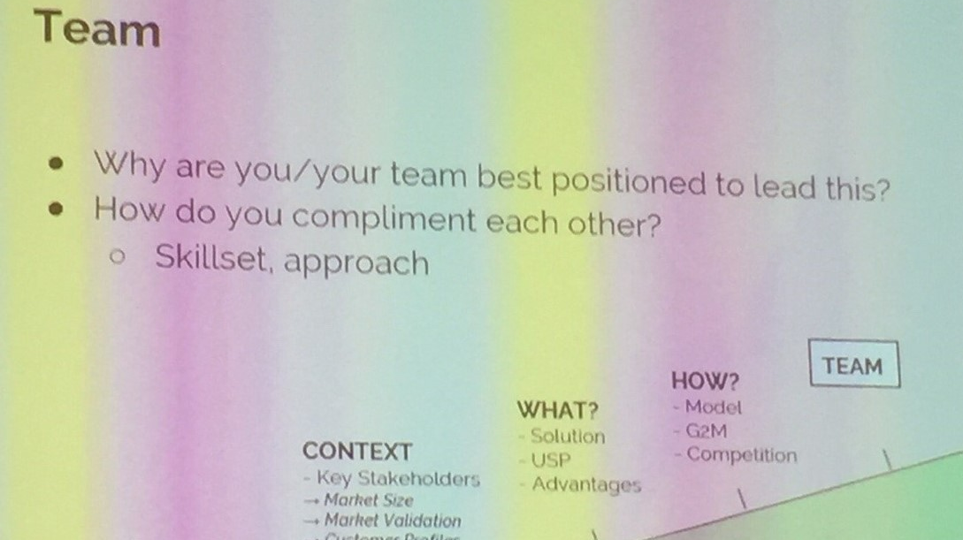

Slide 9
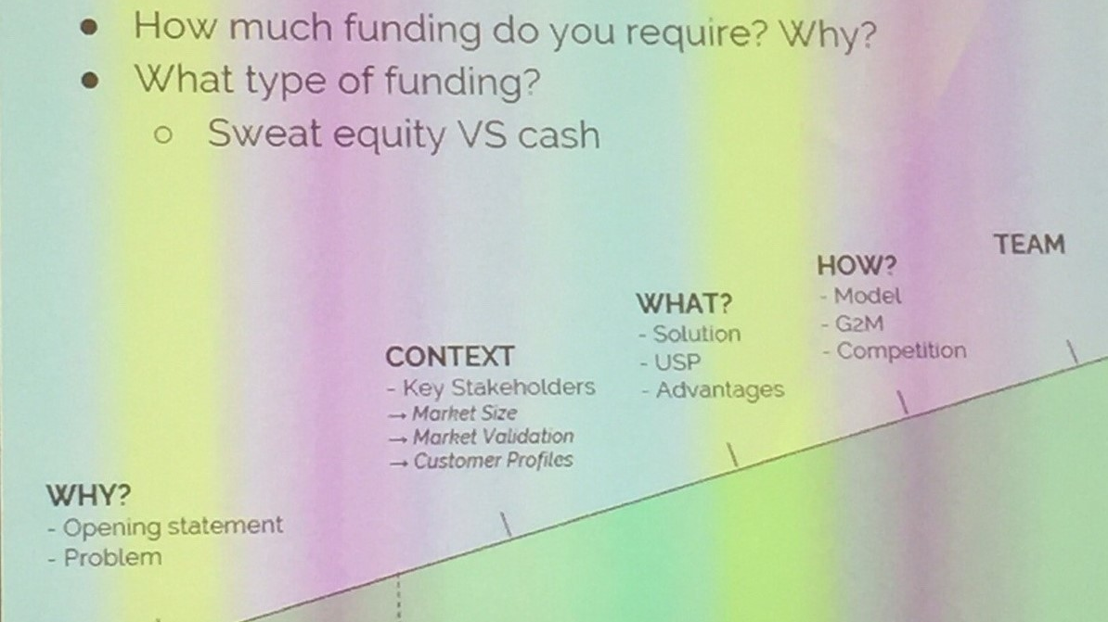
The Ask

Slide 10
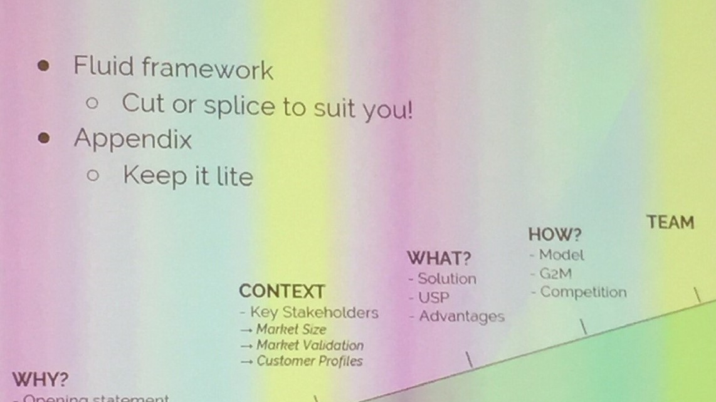
The refresh

Slide 11
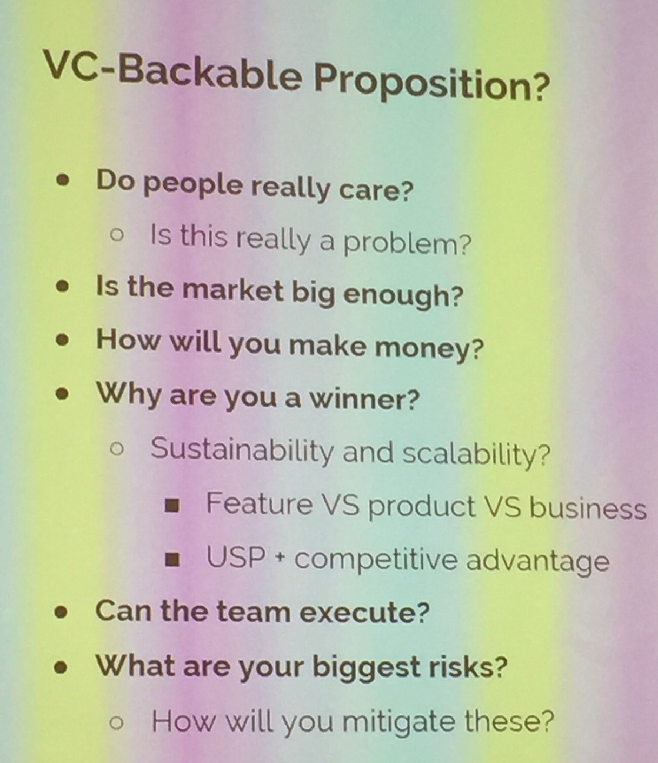

Slide 12
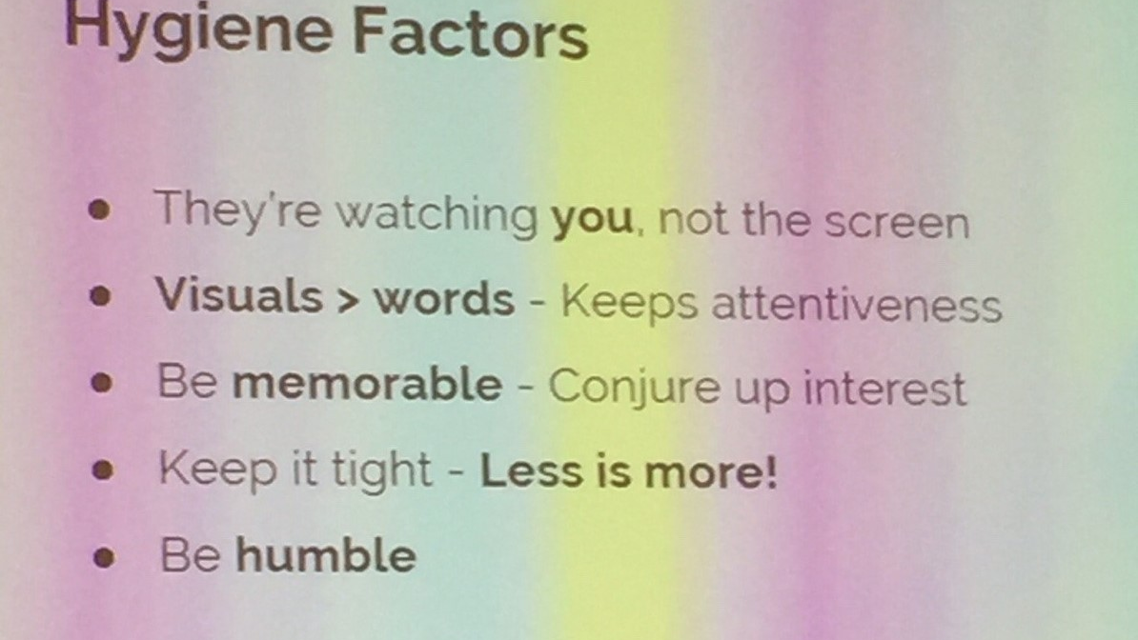

Slide 13
Pitch Framework

